Slide 1
Mechanical Engineering

Slide 2
What is a Mechanical Engineer?
Mechanical Engineering uses the principles of engineering, physics and materials science to , design, manufacture, and the maintenance of mechanical systems.
it deals with the production and usage of heat and mechanical power for the design, production, and operation of machines and tools.

Slide 3
What do I need?
a mechanical engineer starts with earning a bachelor’s degree in mechanical engineering from a school approved by the Accreditation Board for Engineering and Technology
I plan on attending iupui for a for a 5 year BS/MS degree

Slide 4
School cost $$$$$$$$
Tuition: $258.32\hour
Credit Hours: 14hr
Sub Total: $3,616.48
Approximate Mandatory and Program Fees
General Fee: $343.05
Repair & Rehabilitation Fee $159.96
Program Fee: $600.18
Fees Sub Total: $1,103.19
Total Cost: $4,719.67

Slide 5
But where are the jobs???
There are mechanical engineering jobs all over Indiana I would be interested in working out of Indianapolis

Slide 6
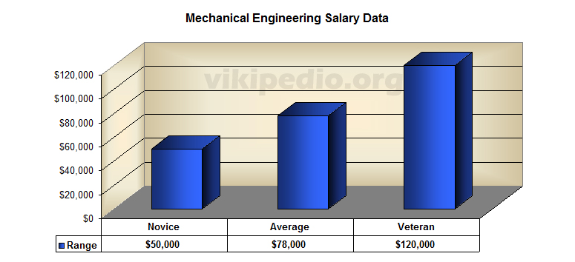
Pay Scale
Hourly of the 50th% is $37.00 and $77,000 annually

Slide 7
Works Cited
http://en.wikipedia.org/wiki/Mechanical_engineering
http://et.engr.iupui.edu/departments/me/undergrad/bsms/index.php
http://www.recruiter.com/salaries/mechanical-engineers-salary/

